Slide 1
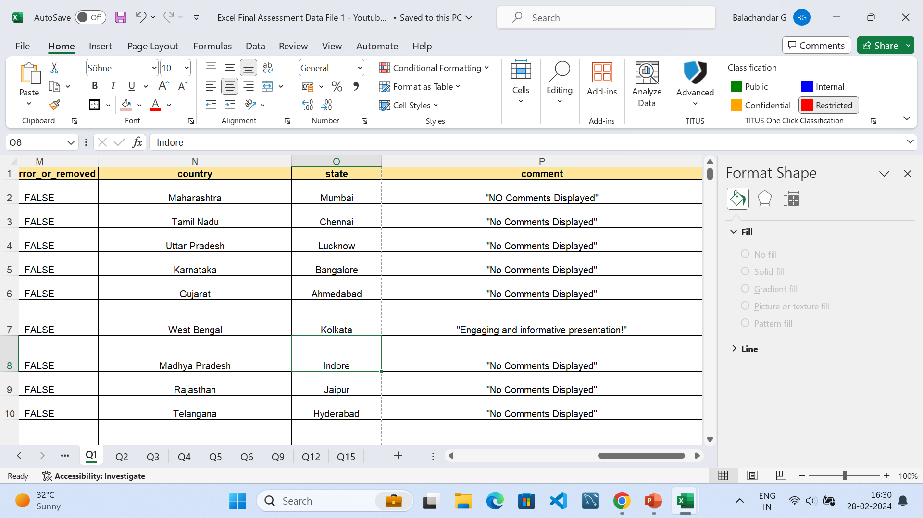
DATA CLEANING
The given dataset is cleaned by removing duplicates using removing duplicates in data tab.
Then the null values in the dataset is nullified by adding “No Comments Displayed”

Slide 2
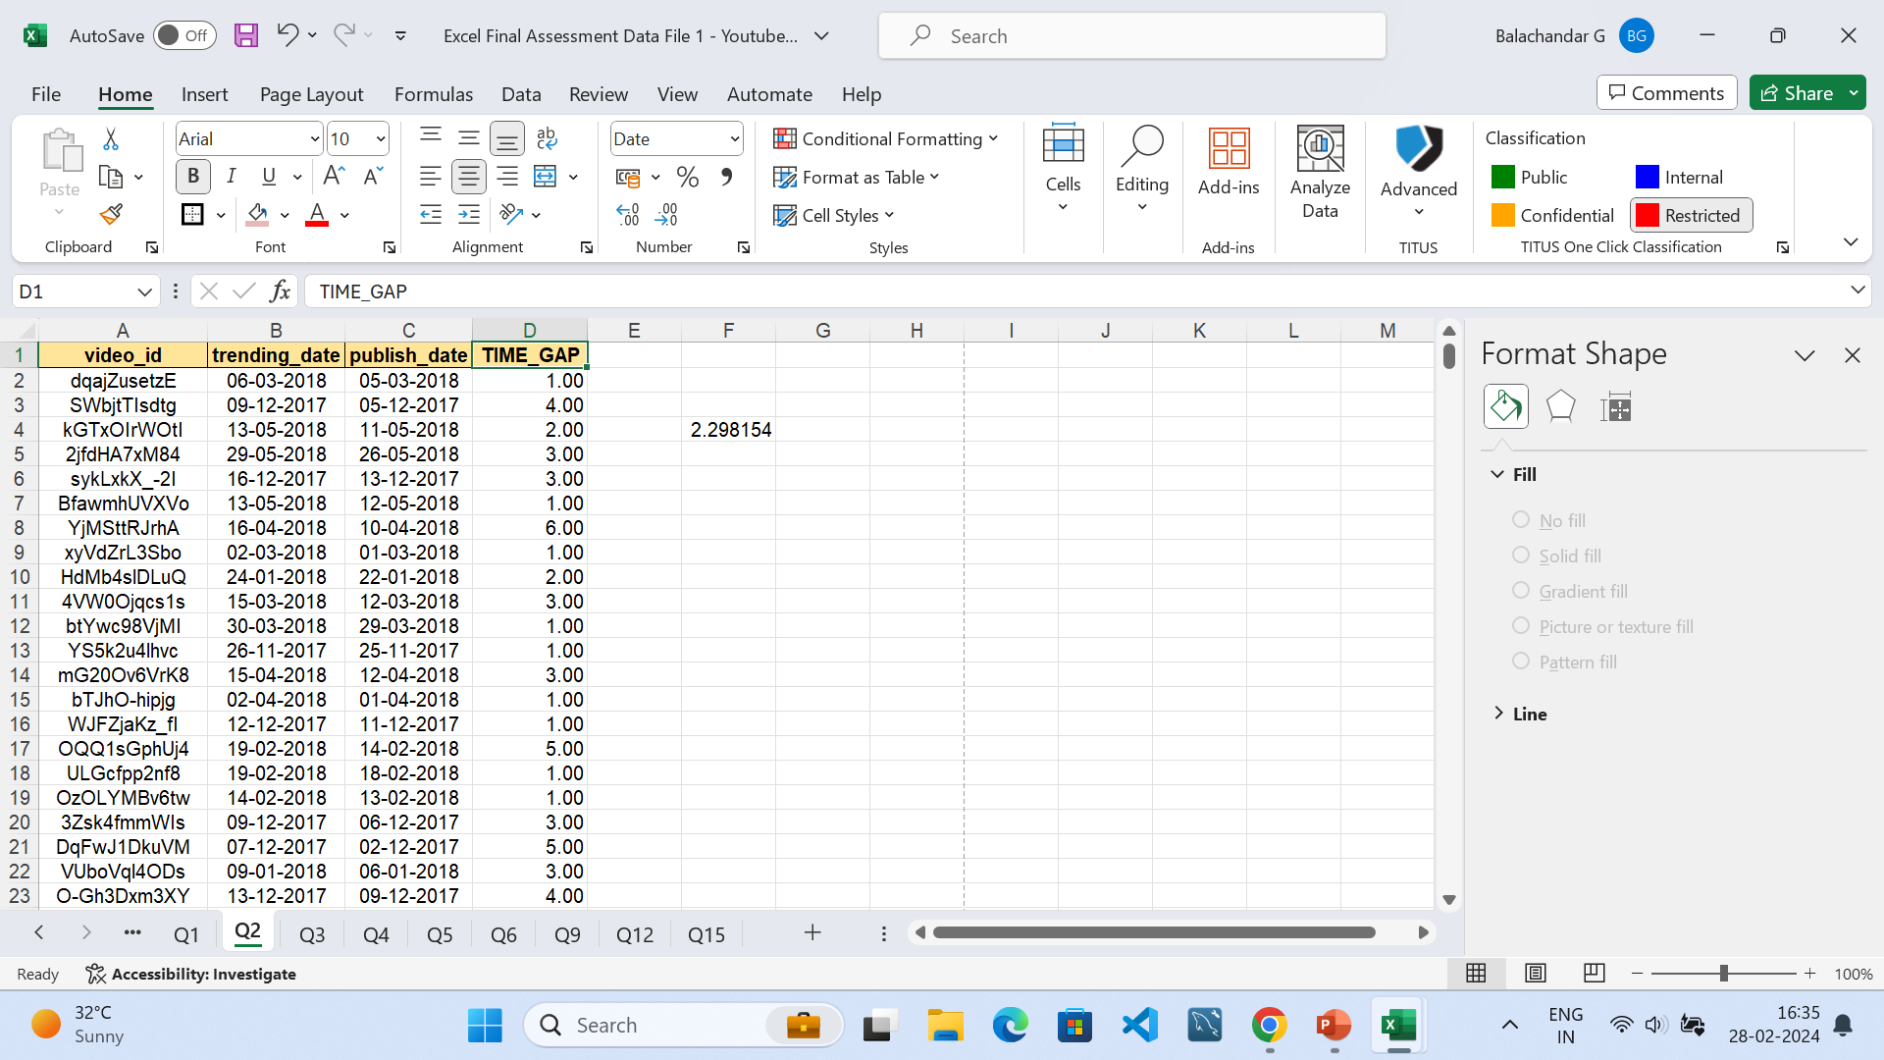
TIME ANALYSIS
The difference in the publishing and the trending date is found using the difference function
The average time delay in the trending and the publishing date is 2.298 days

Slide 3
CATEGORY ANALYSIS
INFERENCE:
People showing more interest in movies rather than educational and religion videos.
The likes and comment are higher for the entertainment category rather than other
Pivot table is created to understand the category wise trends videos

Slide 4
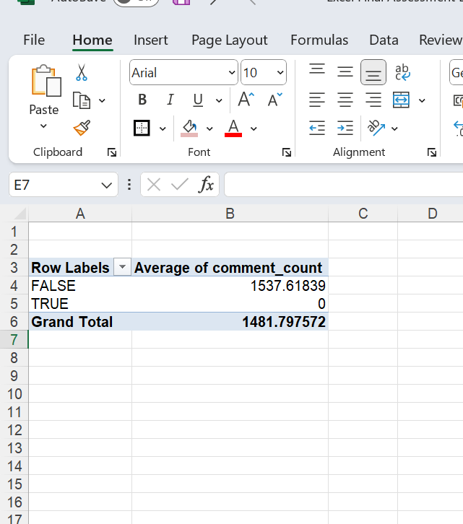
COMMENTS ANALYSIS
The average comment count for the Comments disable is 1481.79,from this it can be inferred that most of the videos they didn’t disabled the comments section.

Slide 5
VISUAL CREATION

Slide 6
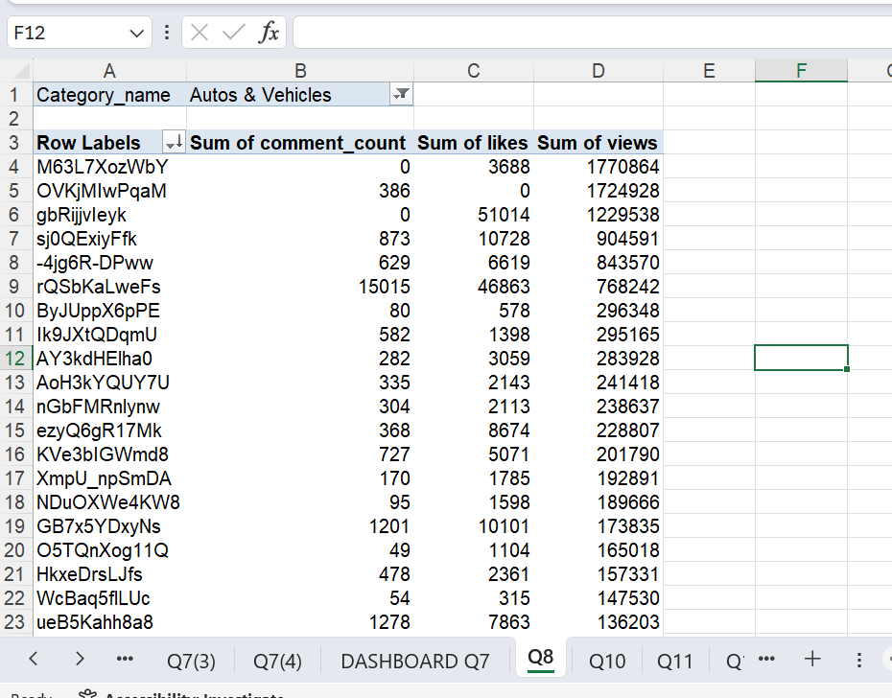
TOP 5
For Example, Autos&vehicle Category Is Selected Based On The Sum Of Views Top 5 Videos Is Collected
Filter Is Used To Find The Category Wise Top 5

Slide 7
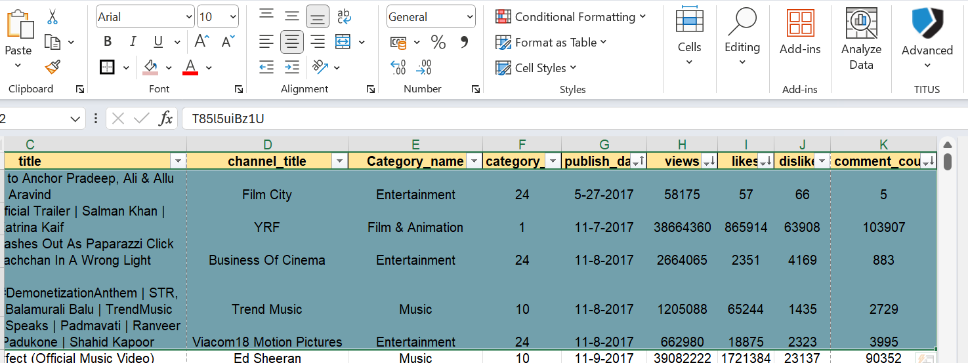
FILTERING BY CONDITION
TOP 5 Videos, Category is selected based on the views,publish date,likes.

Slide 8
GROWTH ANALYSIS
Sum of view is gradually decreases overtime along with the comment count and the likes

Slide 9
COHORT ANALYSIS
The videos released is higher in 2017 qtr1.
The trend for releasing the videos is decreases based on the year.

Slide 10
SENTIMENT ANALYSIS
Entertainment has high number of comments rather than other

Slide 11
COORELATION ANALYSIS
Total Revenue for the view is calculated by assuming the price for one view is 3 rs.

Slide 12
GEOGRAPHIC ANALYSIS
UttarPradesh has highest number of views,while Sikkim has lowest number of views.
Views are based on the population density

Slide 13
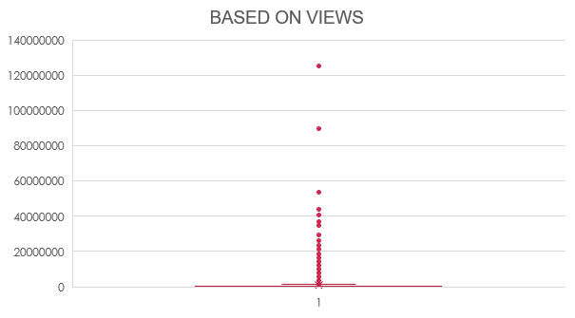
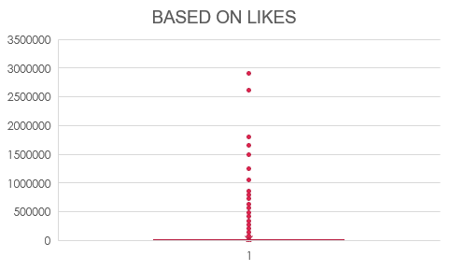
Outerlier
There is 1 outlier on both views and likes

